Slide 1
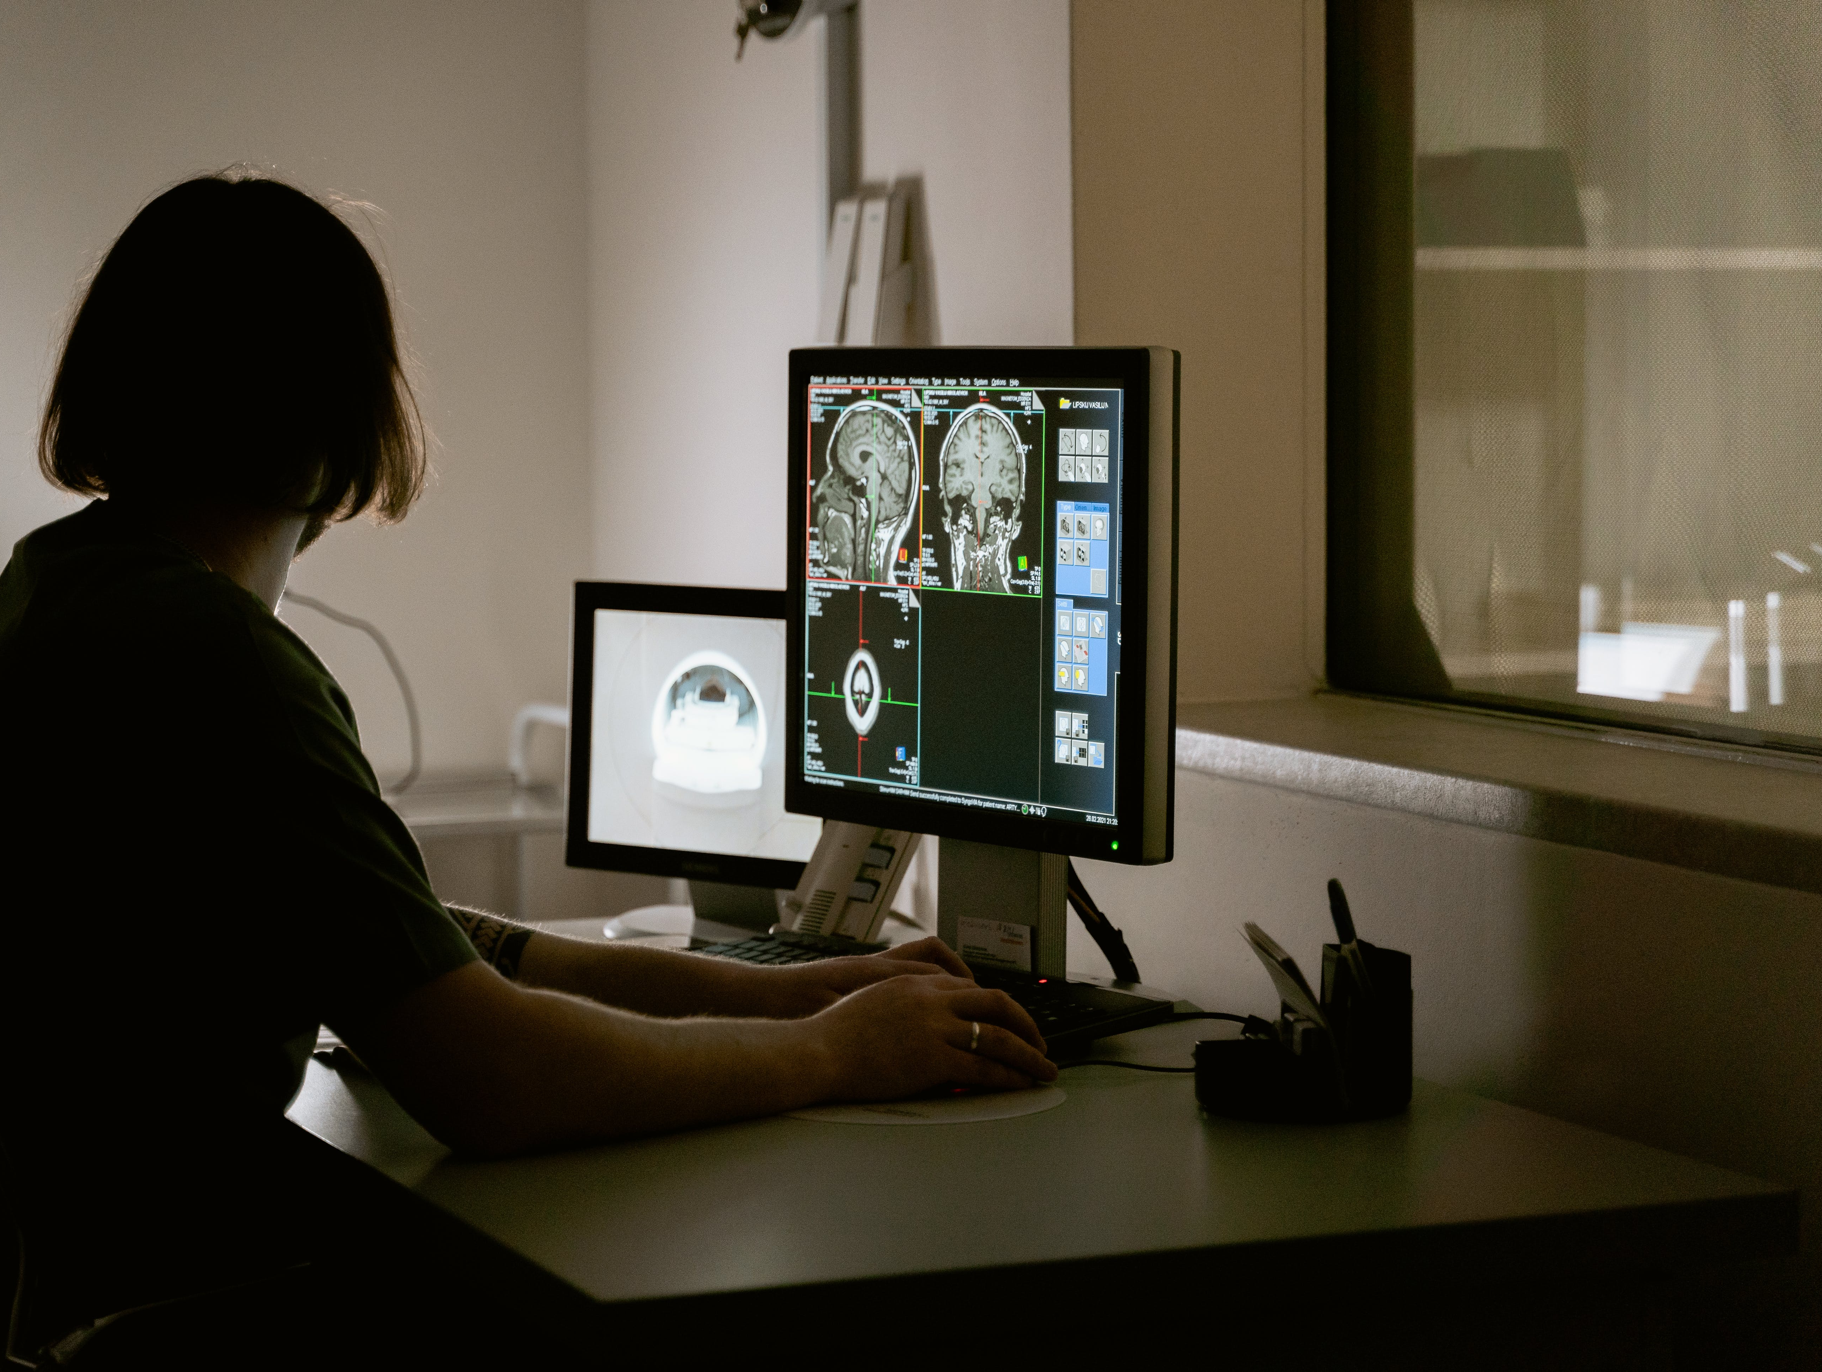

Brain Tumor Detection
Presented By:
D Vamsidhar (24070149005)
Parth Desai (24070149017)
Sagar Joshi (24070149010)

Slide 2
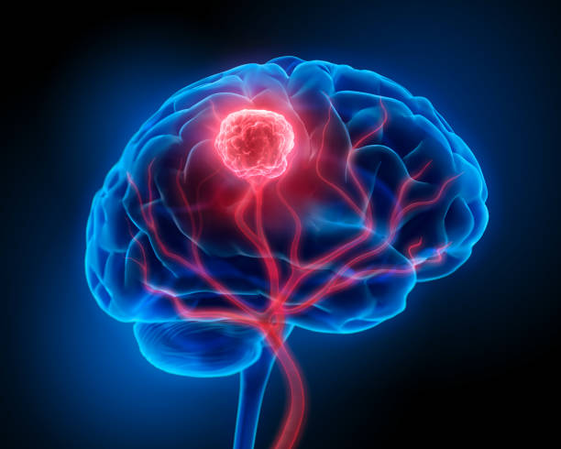
CONTENTS
Introduction
Problem Statement
Objectives
Literature Review
Methodology
Dataset Description
Project Road Map
Work Plan
References

Slide 3
INTRODUCTION
Recent advancements in machine learning, particularly deep learning, enable precise recognition of medical imaging patterns.
This study employs diverse machine-learning techniques, including a Pre-trained deep learning model, on a substantial MRI dataset.
Evaluation of multiple pre-trained deep learning models on a dataset comprising huge number of brain tumor (MRI) images provides insights into their performance.
This research significantly contributes to ongoing endeavors in brain tumor detection, utilizing state-of-the-art machine learning and deep learning techniques, and the results are compared with existing literature to advance our understanding of effective approaches in brain tumor detection.

Slide 4
PROBLEM STATEMENT
Brain tumor detection is a critical task in medical imaging. Traditional methods are often computationally expensive and require large datasets. Transfer learning offers a promising solution. The goal is to leverage pre-trained deep learning models, trained on massive datasets, to accurately classify whether the tumor is present or not with help of MRI brain images and also to use Explainable AI. This approach aims to improve detection accuracy, reduce the complexity of building new model to detect brain tumors and, also use XAI to explain which features did the model consider to detect whether the tumor is present or not.

Slide 5
OBJECTIVES
To detect the brain tumor accurately.
To leverage the maximum capacity of pre-trained models.
To implement the advances of machine learning and deep learning.

Slide 6
LITERATURE SURVEY
Previous Study
1) Title: “MRI-based Brain Tumor Detection using Convolutional Deep Learning Methods” (2023)
Methodology:
Dataset: MRI images (glioma, meningioma, pituitary tumors, healthy brains)
Techniques: 2D CNN, Auto-encoder Network, Machine Learning, Deep Learning(U-Net, ResNet, ViT), XAI.
Results:
Accuracy: 2D CNN (93%), Auto-encoder (90%)
KNN achieved the highest ML accuracy (86%)

Slide 7
LITERATURE SURVEY
2) Title: “Brian Tumor and Glioma Grade Classification using Gaussian CNN” (2022)
Methodology:
Dataset: MRI images (glioma, meningioma, pituitary tumors, healthy brains), TCIA (The Cancer Imaging Archive)
Techniques: Gaussian Convolutional Neural Network, Edge Detection and Contouring for Image Preprocessing
Results:
Accuracy: 98.7%

Slide 8
LITERATURE SURVEY
3) Title: “Intelligent Ultra-Light Deep Learning Model for Multi-Class Brain Tumor Detection” (2022)
Methodology:
Dataset: CE-MRI Dataset (Glioma, Meningioma, Pituitary)
Techniques: Intensity Normalization, Augmentation, UL-DLA (Ultra Light – Deep Learning Architecture), GLCM (Gray Level Co-occurrence Matrix)
Results:
Accuracy of UL-DLA: 96.88%
Accuracy of GLCM using SVM: 86.26%

Slide 9
LITERATURE SURVEY
Summary:
After the literature survey, we concluded that the existing solutions are expensive computationally due to building the models from scratch. To solve this problem, the pre-trained models will be an effective solution to improve the accuracy and capture maximum features from the images. To further improve the output, using Explainable AI will be employ the advances of deep learning which will share the features which the model considered to detect the tumor.

Slide 10
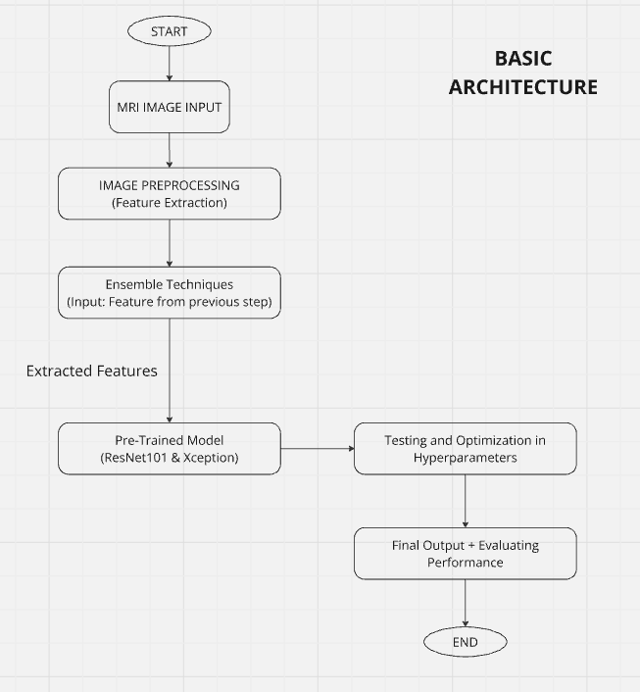
METHODOLOGY

Slide 11
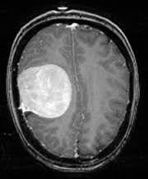
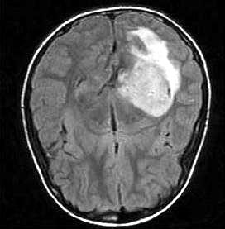
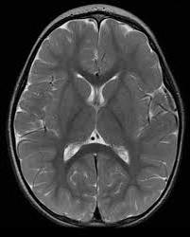
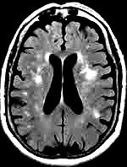
DATASET DESCRIPTION
Dataset Information: Brain MRI Images
Images with Brain Tumour
Images without Brain Tumour

Slide 12
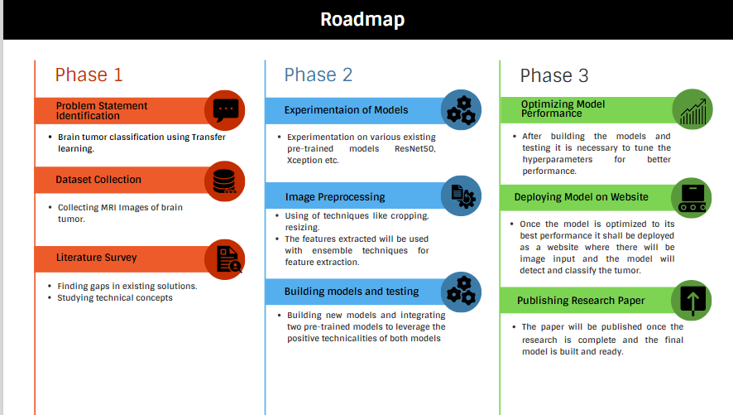
PROJECT ROADMAP

Slide 13
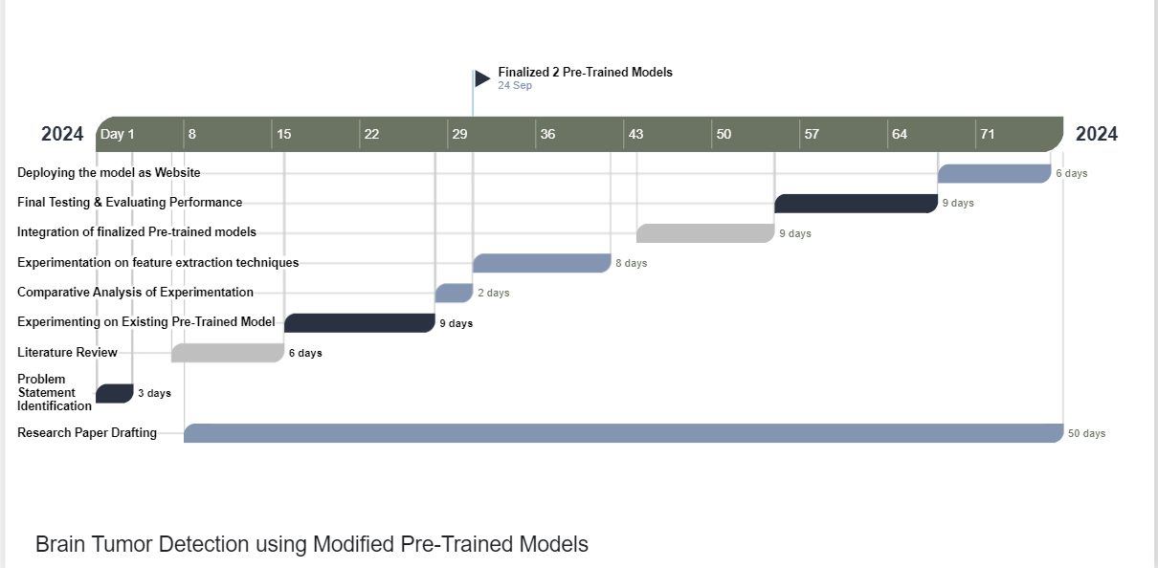
WORK PLAN

Slide 14
REFERENCES
M. Rizwan, A. Shabbir, A. R. Javed, M. Shabbir, T. Baker, and D. Al-Jumeily Obe, “Brain Tumor and Glioma Grade Classification Using Gaussian Convolutional Neural Network,” IEEE Access, vol. 10, pp. 29731–29740, 2022, doi: 10.1109/ACCESS.2022.3153108.
S. A. Qureshi et al., “Intelligent Ultra-Light Deep Learning Model for Multi-Class Brain Tumor Detection,” Applied Sciences (Switzerland), vol. 12, no. 8, Apr. 2022, doi: 10.3390/app12083715.
Dr. Prof. M. Sharma, M. Gahlot, and S. Chaudhary, “Brain Tumor Detection Using Deep Learning,” INTERANTIONAL JOURNAL OF SCIENTIFIC RESEARCH IN ENGINEERING AND MANAGEMENT, vol. 07, no. 12, pp. 1–10, Dec. 2023, doi: 10.55041/IJSREM27567.
H. ZainEldin et al., “Brain Tumor Detection and Classification Using Deep Learning and Sine-Cosine Fitness Grey Wolf Optimization,” Bioengineering, vol. 10, no. 1, Jan. 2023, doi: 10.3390/bioengineering10010018.

Slide 15

Thank you

